Slide 1
WELCOME!
TBI-BH ECHO
Traumatic Brain Injury – Behavioral Health ECHO
UW Medicine | Psychiatry and Behavioral Sciences

Slide 2
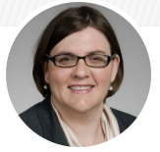
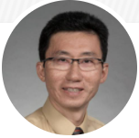
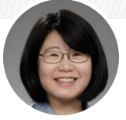
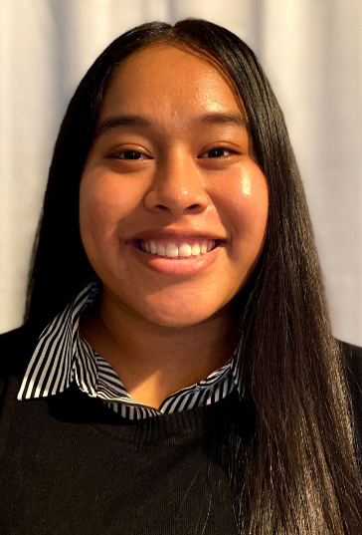
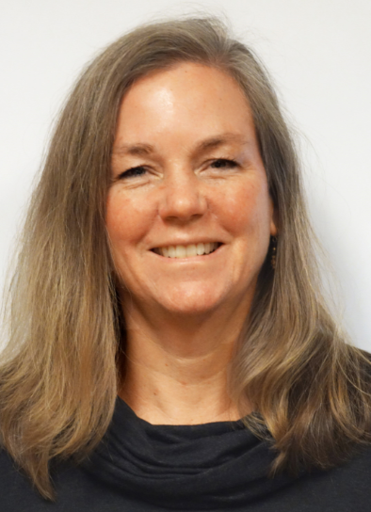
TBI-BH ECHO
Traumatic Brain Injury – Behavioral Health ECHO
UW Medicine | Psychiatry and Behavioral Sciences
Panelists:
UW Psychiatry & Behavioral Sciences | UW Rehabilitation Medicine
Jennifer Erickson DO Jesse Fann MD MPH | Cherry Junn MD Chuck Bombardier PhD
Program Support:
Esther Solano, BA
Program Coordinator,
UW AIMS Center
Cara Towle, MSN RN
Associate Program Director,
Harborview Behavioral Health Institute Training Workforce & Policy

Slide 3
TBI-BH ECHO
Traumatic Brain Injury – Behavioral Health ECHO
UW Medicine | Psychiatry and Behavioral Sciences
WHAT: Connecting front-line providers with specialists to discuss evidence-
based treatments and case consultation on management of behavioral
health problems in patients with TBI.
WHEN: Monthly online clinic held 1st and 3rd Fridays
12:00-1:30 PM PST
WHO: Any provider based in any setting who are managing patients with
post-TBI behavioral health problems.
HOW: Join us via Zoom real-time, interactive video teleconference
REGISTRATION: https://redcap.link/sjje045p

Slide 4
Agenda
Please chat in your Name, Role, and Organization
Didactic presentation
Case discussion
Housekeeping:
Please add your name to your video screen
Please keep yourself on mute
Please type your questions in the chat box
Logistics questions
Content/clinical questions
This session is being recorded

Slide 5
CME Accreditation

Slide 6
Disclosures
Today’s speaker has no financial relationships with an ineligible company relevant to this presentation to disclose.
None of the planners have relevant financial relationship(s) to disclose with ineligible companies whose primary business is producing, marketing, selling, re-selling, or distributing healthcare products used by or on patients
*All relevant financial relationships have been mitigated*

Slide 7
General Disclosures
We gratefully acknowledge receipt of educational grant support for this activity from the
UW Medicine Garvey Institute
for Brain Health Solutions.

Slide 8
In Partnership with…

Slide 9
Didactic Presentation

Slide 10
ANNOUNCEMENTS

Slide 11
2024 Upcoming TBI-BH ECHO Presentations
April 5: TBI & Telemedicine Update
April 19: Post-TBI Return to Sexuality
May 3: Post-TBI Return to Work
May 17: Post-TBI Return to Play
June 7: TBI & Telemedicine Update
June 21: Post-TBI Depression

Slide 12
Integrated Care Conference 2024
Cultivating Integrated Care within the Behavioral Health Ecosystem
Thursday, June 6-7, 2024, DoubleTree SeaTac
Keynote Speakers
Virna Little, Psy. D, LCSW-r, MBA, CCM, SAP, will address integrated care within a behavioral health ecosystem
Loretta Christensen, MBA, MSJ, FACS, will address creating community based programs within the Indian Health Service
Conference Breakout Threads
Building Connections Across the Behavioral Health Ecosystem
Integrated Care Skills Workshops
Workforce Strategies in Integrated Care
Pre-Conference Skills Sessions
Registration is now open: https://cvent.me/g8WkRn?locale=en
Please email uwictp@uw.edu for more information or visit http://ictp.uw.edu/training/upcoming-conferences-events-training
Scan for more information

Slide 13
Community-Based Integrated Care Fellowship Applications open
This fellowship welcomes psychiatric providers seeking additional training to deliver integrated care in community-based settings
CME-accredited and is free for Washington State providers
WHEN: September 2024 – June 2025
APPLY: Visit ictp.uw.edu/apply; deadline to apply is April 29
REQUIREMENTS:
active medical license
Current practice
Brief personal statement
Current CV
Letter of support from current employer, if employed
Scan for more information

Slide 14
TBI Skill Builder
Skill Builder is a 4–5-hour course designed for anyone working with TBI. It can be completed at your own pace. Available online 24/7.
SafeKids Washington
SafeKids is a series of training modules and learning resources for parents, caregivers and youth. Connect with local coalitions for safety and prevention awareness efforts, such as helmet and lifejacket distribution, traffic and pedestrian safety, and more.
Return to School
Return to School is designed to support parents, caregivers, school faculty, administrators, sports coaches and athletics staff with awareness and tools to prevent injury, identify TBI, access resources, and provide support around TBI at school and during school activities.
TBI Resources and Workbook
Comprehensive TBI workbook filled with information, resources, journal prompts and more. Free download available for personal or client use.

Slide 15
Telephone Consultation Services*
for Washington State Healthcare Providers
Psychiatry Consultation Line (PCL)
Adult psychiatry and/or addictions questions
Now accepting calls from non-prescribers M-F 8am-5PM
877-WA-PSYCH (877-927-7924) | pclwa@uw.edu | https://pcl.psychiatry.uw.edu/
*No cost
Partnership Access Line (PAL)
Child and adolescent psychiatry questions
866-599-7257 | paladmin@seattlechildrens.org | www.seattlechildrens.org/PAL
Perinatal PCL
Behavioral health questions related to pregnancy and postpartum
Now accepting calls from non-prescribers M-F 9 am – 5pm
877-PAL4MOM (877-725-4666) | ppcl@uw.edu | www.perc.psychiatry.uw.edu/perinatal-pcl

Slide 16
Pain Management support
for Washington State Healthcare Providers:
Telephone Consultation*
UW Pain & Opioid Provider Consultation Hotline
Guidance re complex pain medication regimens, particularly high dose opioids.
1-844-520-PAIN (7246) | Consultation (washington.edu)
CME-accredited Case Conference Series*
UW TelePain series
12:00-1:30 pm, Wednesdays
telepain@uw.edu | https://depts.Washington.edu/anesth/care/pain/telepain
*No cost
CME Accreditation
The University of Washington School of Medicine is accredited by the Accreditation Council for Continuing Medical Education to provide continuing medical education for physicians.
The University of Washington School of Medicine designates this live activity for a maximum of 72 AMA PRA Category 1 Credits™. Physicians should claim only the credit commensurate with the extent of their participation in the activity. (Each session is 1.5 credits)

Slide 17
CME-accredited Series*
for Washington State Healthcare Providers
UW Psychiatry & Addictions ECHO (UW PACC)
12:00-1:30 pm, Thursdays
uwpacc@uw.edu | ictp.uw.edu/programs/uw-pacc
Dementia Project ECHO
12:15-1:30 pm, 2nd and 4th Fridays each month
Register with allysons@uw.edu | https://depts.washington.edu/mbwc/resources/echo
TeleBehavioral Health Training series
3rd Fridays monthly 11.00am – 12.00pm PST
bhinstitute@uw.edu
https://bhinstitute.uw.edu/training-workforce-policy/training/telehealth-support/
*No cost for participation.
*Please see individual websites for CME accreditation information and fees.

