Slide 1
Post-TBI Return to Sexuality
TBI-BH ECHO
Traumatic Brain Injury – Behavioral Health ECHO
UW Medicine | Psychiatry and Behavioral Sciences
Katherine S. Wright, Ph.D., Clinical Assistant Professor
Department of Rehabilitation Medicine
Division of Rehabilitation Psychology and Neuropsychology
Email: wright6@uw.edu

Slide 2
Speaker Disclosures
No conflicts of interest
The following series planners also have no conflicts of interest:
Jennifer Erickson DO
Jesse Fann MD
Cherry Junn MD
Chuck Bombardier PhD
Cara Towle MSN RN MA

Slide 3
Objectives
Sex and sexuality in general
Impact of TBI on sex and sexuality
How and when should the topic come up for you in clinical practice?
PLEASE NOTE: This talk is not designed to prepare you to provide sexual counseling or sex therapy
Notes:
NOTE: Not designed to prepare for sexual counseling/ sex therapy

Slide 4
Objective #1: Overview of Sex and Sexuality
Sexuality: What is it?
Myths about sexuality and disability
Factors impacting sexual function

Slide 5
Let’s Talk about Sex! What is it?
Objective #1
One’s biological identity
Physical manifestations of sexual behavior
Sex ≠ Identity ≠ Expression ≠ Attraction

Slide 6
Objective #1
Notes:
So, your patient is in front of you. They are a person, and they are going to have many different facets of themselves that make up who they are. One aspect of your patient is gender. And this is the Gender Unicorn, who is a sweet infographic to help explain the different parts of gender, such as:
Gender identify – a person’s internal sense of being male, female, neither of these, both, or another gender(s).
Gender expression – the physical manifestation of one’s gender identity through clothing, hairstyle, voice, body shape, etc.
Sex Assigned at Birth: The assignment and classification of people as male, female, intersex, or another sex based on a combination of anatomy, hormones, chromosomes.
Physically Attracted To: Sexual orientation.
Emotionally Attracted To: Romantic/emotional orientation. There are other types of attraction related to gender such as aesthetical or platonic.
So, going back to the patient in front of you, they had a gender identity before whatever happened to them happened that brought them in for your clinical visit and they will continue to have a gender identity after injury. This is an individual process for each patient to navigate their overall identity, including gender, in the context of this new injury or way of functioning.
You can learn more at https://transstudent.org/gender/

Slide 7
What is Sexuality?
Objective #1
Sexuality is a combination of many factors
Sex
Feelings
Behaviors
Sexual identity
Social expectations/structures (religion, politics, socioeconomic status, medicine)
Personal, individual
Notes:
Sexuality is a combination of many factors. Gender is part of this, sex, feelings, behaviors, and sexuality is influenced by our experiences, legal, political and cultural contexts, etc. Each of us expresses sexuality differently. And everyone has sex differently at baseline – sex with a partner, no sex, solo sex, identifying as asexual.
Think of your last two relationships – sex was probably really different between them because your interactions were different.
So, sex also changes through the lifespan, because of experiences, different interactions, etc. And your patient’s sexuality – or asexuality – may or may not have been affected their injury.
Sexuality, to put it simply, is complicated.

Slide 8
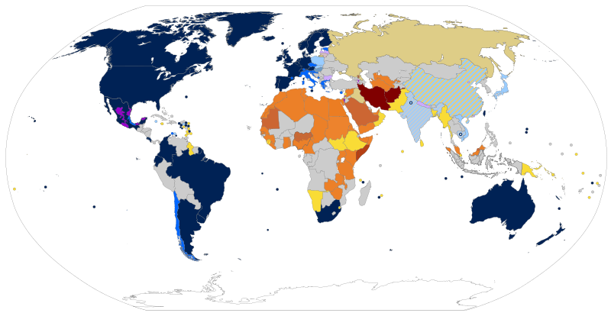
Cultural Differences to consider:
Objective #1
Wide spectrum of beliefs and practices globally
e.g., legality of homosexual relationships and expression:
File:World laws pertaining to homosexual relationships and expression.svg. (2021, November 12). Wikimedia Commons, the free media repository. Retrieved November 13, 2021 from https://commons.wikimedia.org/w/index.php?title=File:World_laws_pertaining_to_homosexual_relationships_and_expression.svg&oldid=606732609.
Notes:
As one example of the way culture can affect sex, the experience of same-sex relationships is really different worldwide.
In blue, these are countries with limited recognition up to legalization of same sex marriage.
In gray, same sex unions are not recognized.
And yellow to red shades represent countries with laws that actively criminalize homosexuality with punishment all the way to death (dark red)
---------------
The overarching culture and laws where people live have the potential to massively affect the way people experience sex and their own sexuality and how safe they feel expressing themselves.
For example, the legality of same-sex relationships varies widely across different countries.
On this map, in blue shades, these are countries where there is some limited recognition up to legalization of same sex marriage.
In gray, same sex unions are not recognized.
In tan, there are laws restricting freedom of expression and association
And countries in Yellow to Red shades have laws that actively criminalize homosexuality with punishment escalating in severity all the way to death (dark red)

Slide 9
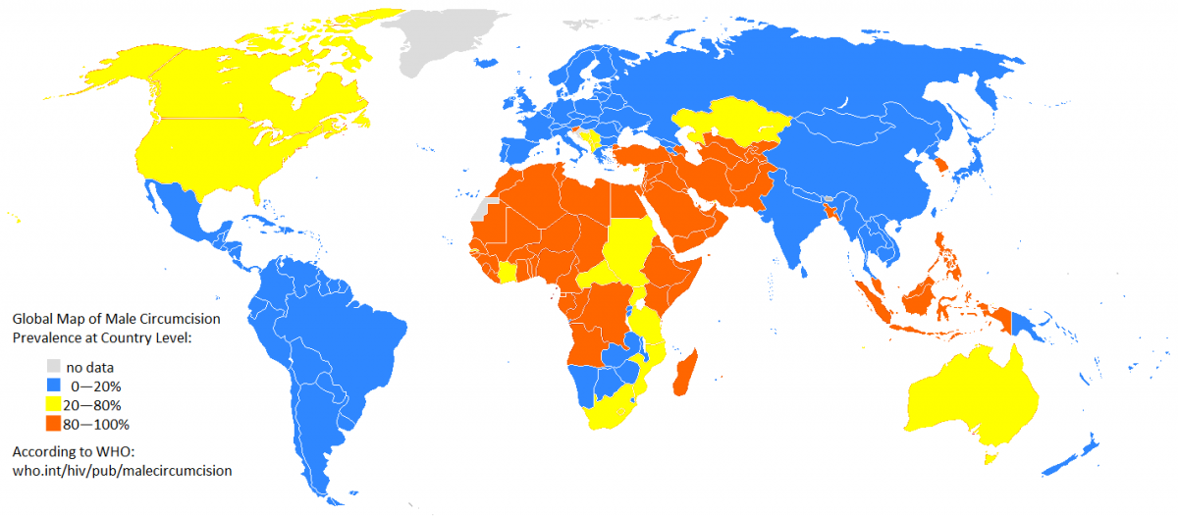
Cultural Differences to consider:
Objective #1
Another example: male circumcision
Notes:
Another example of cultural differences is how widely varied the practice of male circumcision is. In blue are places where circumcision is much less prevalent and orange marks countries where circumcision is practiced by the majority.

Slide 10
Objective #1
Take Aways:
Sexual health is key to wellbeing!
Notes:
- Hopefully this underscores that sexual health is key to wellbeing!
- Patients will all vary in the level of importance they place on it both pre- and post-injury, when they want to address it after an injury, in how they address it, etc.
But the important part is that we offer patients opportunities to address it if they want and meet them where they are. If it hasn't been on the table prior to seeing you, then your visit is an opportunity to offer time to think about how sex and sexuality fits into life now.
Additionally, your patients' interest or questions or concerns related to sex may change over time, so it’s helpful for all members of a multidisciplinary team, inpatient or outpatient, to be prepared in some way to discuss these topics.
Because if we don’t, we are missing SOME aspect of their health, and we want to take care of the whole person.

Slide 11
Myths about Sex and Disability
Objective #1
People who have a cognitive or physical disability are asexual; they can’t engage in sexual activities and they don’t want to.
Sex is physically painful for people who have disabilities.
Having to plan new positions and strategies for having sex ruins the experience and destroys intimacy
What myths have you encountered?
Notes:
So, now that we’ve covered sex and sexuality and touched on the different facets and influences of those terms, let’s debunk some myths about sex and disability.

Slide 12
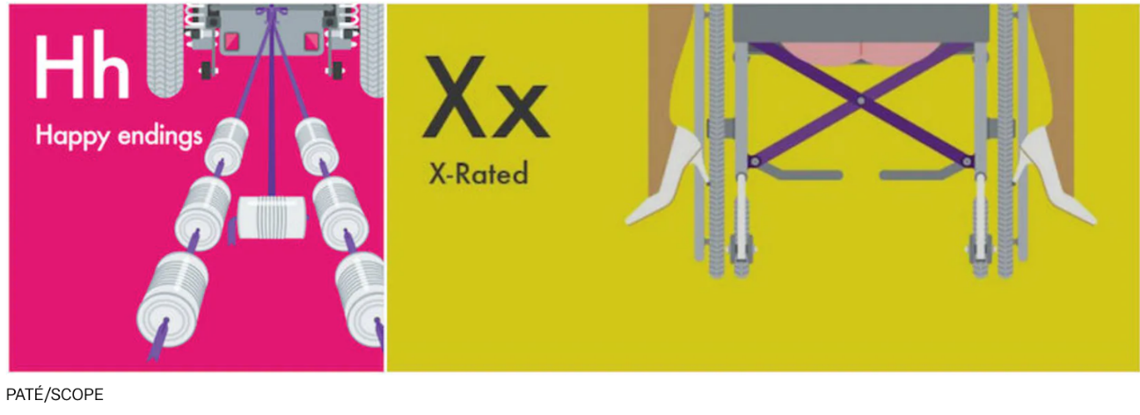
The True Truth
Objective #1
Sex is something to consider for everyone, with or without a disability.
We can’t assume anything about the role sex does or doesn’t play in someone’s life.
Cartoons by Pate (aka, Paul Pateman). Kutner, Jenny. These Cheeky Alphabet Cartoons Are Busting Myths About Sex and Disability. (2015, November 20). Mic. Retrieved November 14, 2021 from https://www.mic.com/articles/128954/these-cheeky-alphabet-cartoons-are-busting-myths-about-sex-and-disability.
Notes:
Sex is something to consider for everyone, with or without a disability. However, historically, people with disabilities were often considered asexual. One factor likely perpetuating this was sexuality was not addressed by healthcare providers. It really wasn’t until the late 60’s that sex began to be incorporated into medical education.
Also, the cartoons are from a UK campaign to change attitudes and normalize sex and disability – with some specifically about disability (A is for Amputee) and most are simply parts of sex (I is for intimacy, O is for Orgasm).
----------
Kutner, Jenny. These Cheeky Alphabet Cartoons Are Busting Myths About Sex and Disability. (2015, November 20). Mic. Retrieved November 14, 2021 from https://www.mic.com/articles/128954/these-cheeky-alphabet-cartoons-are-busting-myths-about-sex-and-disability.
Pride Source Staff. Jim Toy Pride Dinner to award scholar, advocate Sandra Cole. (2012, June 21). Pride Source. Retrieved November 14, 2021 from https://pridesource.com/article/54043/
------------------
Drs. Ted and Sandra Cole are examples of some of the pioneers in this country who pushed for medical doctors to learn more about sex and sexuality and conducted groundbreaking research on topics such as sexuality and physical disability.
In 1968, Dr. Ted Cole was one of the first attendees SAR: Sexual Attitude Reassessment. This was a two-day seminar designed to desensitize people towards a broad range of human sexual activity so they could better counsel, treat, and educate patients about various sexual concerns. Dr. Cole then pushed for this to be built into the medical education at the University of Minnesota’s Medical School – and now the Program in Human Sexuality just celebrated it’s 50th anniversary in 2020.
Dr. Sandra Cole was a professor and certified sexologist who also worked in academic medicine for 40 years. One of her accomplishments was in 1993 founding the University of Michigan Health System Comprehensive Gender Services Program, an academic program providing health care services to transgender individuals in need of gender-related multidisciplinary care, including endocrinological, surgical, mental health, and general health care services. Dr. Cole also co-authored the Ann Arbor, Michigan ordinance on gender identity non-discrimination.
MDs don’t get much education about sexuality in medical school… reproduction, but not sexuality
Typically not the first concern patients have. But most patients are interested.
Some patients embarrassed to ask.
Some settings can accommodate overnights with privacy
The cartoons here were commissioned by the U.K.-based group Scope, a nonprofit advocacy group for people with disabilities, which aims to normalize sex and disability by getting back to basics — starting with the alphabet - as part of its End the Awkward campaign, an effort to change attitudes around disability. Each of the letters Paté designed tackles a different aspect of sex and disability, with some more explicitly representing different disabilities – A is for Amputee, H is for happy endings with the cans attached to a post-wedding vehicle, but this has a power chair, and X is for X-rated, the little cheeks! But – and more importantly - the majority of which are simply parts of sex: I is for "intimacy," O is for "orgasm," P is for "PDA" and, of course, T is for "Tinder."
Kutner, Jenny. These Cheeky Alphabet Cartoons Are Busting Myths About Sex and Disability. (2015, November 20). Mic. Retrieved November 14, 2021 from https://www.mic.com/articles/128954/these-cheeky-alphabet-cartoons-are-busting-myths-about-sex-and-disability.
Pride Source Staff. Jim Toy Pride Dinner to award scholar, advocate Sandra Cole. (2012, June 21). Pride Source. Retrieved November 14, 2021 from https://pridesource.com/article/54043/

Slide 13
What do these have in common?
Objective #1
Depression
Cognitive changes
PTSD
Chronic pain
Sleep problems
Frustration
Alcohol/drug abuse
Medication
Anxiety/stress
Financial problems
Job problems/loss
Relationship problems
Medical conditions
Body image
Notes:
They all affect sex!
And many other things as well
NOTE: PTSD from sexual trauma will especially affect sex and we’ll talk about referral options later in this talk.

Slide 14
Sexual Dysfunction
Objective #1
People with vaginas
Lubrication difficulty
Inability to achieve orgasm
Inability to relax vaginal muscles to allow for intercourse
People with penises
Premature ejaculation
Erectile dysfunction
Absent or delayed ejaculation despite sexual stimulation
In anyone
Lack of interest or desire
Inability to become aroused
Pain with intercourse
Notes:
When thinking about sexual dysfunction, we often think about these more common things

Slide 15
Objective #1
Take Aways:
Sex and sexuality looks different and varies in importance across individuals, disability or not
There are many biological, social, emotional, and environmental, and cultural factors that can affect sexual health
Notes:
Now, let’s get into how TBI factors into this mix

Slide 16
Objective #2: Impact of TBI on Sex and Sexuality
Cognitive changes
Physical changes
Emotional factors, sense of self
Social changes

Slide 17
Sexual Adjustment after Brain Injury
Objective #2
Could include traumatic brain injury, stroke, brain tumor, etc.
Frequent impact on frontal and temporal lobes
Limited expression of emotion
Impulsivity
Brainstem impact
Impaired arousal
Can be highly variable: sex drive increase, decrease or disappear
Spasticity
Notes:
Often the most frequent impact for sexuality comes from damage to the frontal and temporal lobes, changing emotional expression and impulsivity.
Damage to the brain stem can affect arousal.
Although often brain injury results in really variable outcomes – looking like a whole range from sex drive increases to decreases to disappearing
Spasticity and muscle control can affect mobility.

Slide 18
Possible Impacts of TBI: Cognitive Barriers to Sexual Function
Objective #2
Decreased affective expression
Difficulty understanding nonverbal cues
Impaired communication with partners
Difficulty self monitoring
Difficulty discriminating between public and private behaviors
Initiation deficits
Notes:
Decreased affective: lack of emotional expression may appear to be cold
Nonverbal cues: may not understand interest or perceive lack of interest of partner
Impaired communication: turn off partners
Self-monitor: irritability/anger may repel others
Difficulty discriminating between public and private behaviors: inappropriate behavior or timing of behavior
Initiation deficits: may get in the way of them initiating sexual or romantic interest or interactions

Slide 19
Case Example
Objective #2
An inpatient who identified as female and used she/her pronouns, in her late teens with a severe brain injury from stroke
Hypersexual after injury
Very cognitively impaired with low insight into safety precautions
Still technologically savvy, though
Strangers coming to the house expecting romantic encounters when she and her mother were home alone
Notes:
+occasional hypersexuality; doesn’t happen often but is distressing to families
I had a patient in her late teens have a stroke during sex with her boyfriend, after which she became hypersexual and I spent a lot of time working with her mother on ways to cope or redirect or ensure safety when her daughter was really cognitively impaired and disinhibited, but could operate social media and get around parental controls and on several occasions, invited strangers to their home who expected that they would be having some sexual experience.

Slide 20
Possible Impacts of TBI: Physical Barriers to Sexual Function
Objective #2
Nerve damage
Decreased mobility
Spasticity
Bowel and bladder function
Pain
Medications
Notes:
Nerve damage may impact arousal, erectile ability, ejaculation, ability to orgasm, lubrication
Decreased mobility: not able to get into certain positions
Pain: limit positions, decrease willingness to be touched
Medications: antidepressants decrease libido; may contribute to ED

Slide 21
Possible Impacts of TBI: Other Factors affecting Sexual Feelings and Behaviors
Objective #2
Depending on the age at which the individual acquired a TBI, sexual development may be affected
Self-exploration may be discouraged or punished
May have less privacy in which to explore
Protectiveness of parents
Limited peer interaction
Notes:
Could affect self-efficacy and sexual self-esteem
This may be related to parents’ overprotectiveness and negative attitudes of others
Adolescents with disabilities felt sexuality was an important part of their lives but had difficulties developing sexual relationships
30% functioned socially below same-aged peers—they dated later, dated less, and had less sexual experience—but increased over time

Slide 22
Possible Impacts of TBI: Other Factors affecting Sexual Feelings and Behaviors
Objective #2
Body Image
Self-esteem/Confidence
Relationship/Communication
Mood
Role changes re: household tasks, job/finances
Overall disruption to sense of self
Notes:
Factors that people may have been struggling with pre-TBI as well, but now these become more complicated post-TBI.
Ashamed/embarrassed about their body; see themselves as less.
Mood can be affected in general – depression, etc.
Fear/anxiety/embarrassment re: TBI
One patient’s partner reported it was hard to navigate holding all of these roles – being a caregiver, doing their partner’s bathroom care, and being their lover as well

Slide 23
Case Example
Objective #2
Inpatient who identified as male and used he/him pronouns, in his 40s with a severe TBI from a scooter crash
Hospitalized for more than 2 months at the time of this encounter
He had received a care package and given the way he described this person, it sounded like this was from a romantic partner
When I asked about their relationship, he said: “Oh, no, she’s engaged, and frankly, he can offer her so much more. I’m just… nothing now, I would be disappointing.”
Notes:
Another example I encountered on the inpatient unit. This was a patient who had a severe TBI and had been hospitalized for more than 2 months at the time. He was showing me some parts of a care package he had received and it sounded like this was from a romantic partner, but when I clarified, he said, “oh, no, she’s engaged, and frankly, he can offer her so much more. I’m just, nothing, now, I would disappointing.”
He just smiled matter-of-factly like this is truth
Great fodder for brief cognitive therapy

Slide 24
Possible Impacts of TBI: How Others View Them
Objective #2
Partner “turned off” by changes in person
Prejudices of others
Role changes may cause tension, affecting libido, arousal
Fear over hurting the person with TBI
Notes:
+Sometimes increased interest and initiation without ability to follow through
Miller et al., 1986; Zencius et al., 1990)
+Review: lit sparse, case studies, difficult to generalize
+Aloni & Katz (1999) review: unable to differentiate between primary and secondary sexual problems after TBI

Slide 25
Objective #2
Take Aways:
These are factors that are possible post-TBI, but not necessarily true for everyone
Everyone is likely experiencing sexual adjustment differently
You don’t need to remember all of these factors, you just need to ask
Notes:
The most important thing to take away from this is that sexual adjustment can POSSIBLY be affected by these things, but there may be other factors that these affecting your patient’s sexual experiences, or none of these things may be happening. So, the most important thing is to remember that everyone is likely experiencing sexual adjustment differently, and you don’t need to remember all of these factors, you just need to ask.

Slide 26
Objective #3: How and when should the topic come up for you in clinical practice?
Whose job is it to discuss this?
How do we talk about it? PLISSIT Model
Putting it into practice

Slide 27
Addressing Sex and Sexuality post-TBI
Objective #3
Whose job is it?
PT?
PA? SLP?
MD? SW?
OT? Counselor?
RN?
TR? ARNP?
Rehab Psych?
P&O? Voc?

Slide 28
How do we talk about it?
Objective #3
Recent study suggested that for the cohort of PT students involved, knowledge of sex and disability increased over time, but discomfort with the topic also increased over time in training.
So, what do you need to know?
Wittkopf et al., 2018

Slide 29
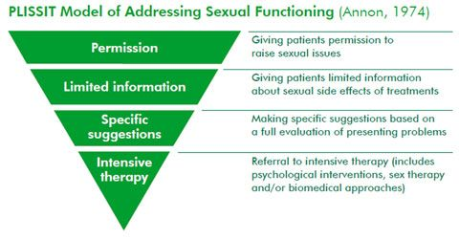
PLISSIT Model (Annon, 1974)
Permission to be sexual
Limited Information
Specific Suggestions
Intensive Therapy
Objective #3

Slide 30
Permission
We can all do this level
Be matter-of-fact
Acknowledge sexuality as potentially an important part of life
Normalize having questions/concerns about sexual function
“Many of my patients have questions about sex after an injury like this. Also, if I don’t have the answer, I can always point you to another provider who may.”
Notes:
+P: responsibility lies w/HCP; and one of the most critical parts of this is to ask EVERYONE and make information about healthy sexuality available to all people regardless of age or the presence of a partner.
- Pts often think it is inappropriate to ask or assume there is no hope for having sexual activity after their disability;
- but anyone who feels comfortable w/the topic can do this;
- bringing up topic gives permission to ask questions, have interest; permission to explore, experiment
For example, I ask all my patients with a new brain injury about their sexuality, “is it okay if I ask these questions to you now?’ or ‘My patients with TBI often have questions about how TBI may affect their sex life. What questions, if any, have come up for you since this happened?”

Slide 31
Two-Person Practice: Giving Patients Permission to Discuss Sex
Objective #3
An exercise you can test out later with a colleague, friend, or anyone willing to let you practice, if you want to try it out before having this conversation with a patient
One person take the role of the therapist
Second person take the role of the patient
Open up the topic of sex and sexuality
Notes:
It’s not quite the format to do this, but you should test it out w/ a colleague or anyone willing, honestly! Any practice just helps you get comfortable w/ the language, wording, topic in general

Slide 32
Two-Person Practice: Questions to Try
Objective #3
Possible opener before a question:
Many people have questions about sex after an injury like this.
Followed by questions like:
What questions have come up for you about sex since this TBI?
How has the TBI affected your sexual functioning?
Was sex an important part of your life before this?
Is there anything you would want to know or change about sex since this injury? [response] Tell me more.
How has the TBI affected your expression of sexuality?
Notes:
Ask your colleagues what questions come up for them regularly and what they tell patients.
You can learn some great techniques from the people you work with.

Slide 33
Limited Information
You should have accurate information and be comfortable providing that information
Basic physiology and pathophysiology of sexual response cycle
The importance of accommodating cognitive deficits:
Attention/focus can be important to staying aroused or to achieve orgasm, so setting up the environment to be less distracted
Plan for times of day when all parties are less fatigued and can discuss/plan with more cognitive control
Notes:
Can be done by most professionals
+LI: Limited Information means the broader strokes, more general education. Provide info, clarify, dispel myths---Need to know what you are talking about; Will it hurt him to have sex? Can sex cause a stroke?
You may be just be able to provide a menu of options for certain problems, even if you don’t know the specifics, and then have a referral idea in case they have additional questions.
e.g., that there are a number of treatments for erectile problems: penile implants, injections, vacuum pumps, medications
Depending on what kind of physical concerns a patient has – and especially if they haven’t had a good medical work up, it is important to recommend that they have a comprehensive medical exam, which could include lab tests (urine, blood work) or more specific exams (gynecology or urology).

Slide 34
Empowering Patients’ Self-Advocacy
Objective #3
Suggestions per Nick Simkins’ article on Sexual Dysfunction following brain injury | CNS (neuroskills.com)
Empower your patients to get their thoughts down on paper ahead of meeting with their doctor.
Given that many patients with TBI benefit from additional time or other accommodations to facilitate communication due to cognitive deficits, preparation ahead of time could be helpful.
Notes:
Nick writes: “The only way that your doctor is going to have the information about your situation following injury is if it is provided by you, or someone on your behalf. Since the doctor may not inquire about it, as a part of the history, and since it is important to provide complete information, the following is suggested. It is suggested that you actually make a copy of this form, fill it out, and hand it to your doctor at your next appointment to start the conversation that may lead to a more fulfilling life for you and your partner.”

Slide 35
Empowering Patients’ Self-Advocacy, continued:
Objective #3
Example of a such a letter or form to complete and give to their doctor:
“Dear Dr. _________:
“Since my injury, I have noticed a change in my sexual functioning, and I am providing you with this information, and any other information that you might need to evaluate my situation. Can you help me, or refer me to a doctor or health care provider who could help me with this change in my sexual functioning?
“Then, provide in that same letter, the following information:
A brief description of your sexual pattern in the year before injury;
A description of your sexual pattern since the injury;
An honest appraisal as to your desire for sex since the injury;
How has the sexual situation been handled between you and your partner since the injury, in terms of any discussion;
List all of your medications that you have been on since the injury, and ask "could any of these be affecting my sexual function?"
Are there any specialists to whom you could refer me for evaluation of my sexual dysfunction, and treatment;
Is there any information that I can provide to you, at this appointment, or at the next appointment, to help you in evaluating, diagnosing, and treating my condition?”
Notes:
“Any other information that you think would be helpful for the doctor should be written down and given to the doctor.
This should help break the ice about any discussion of sexual dysfunction.”
https://www.neuroskills.com/brain-injury/brain-injury-overview/sexual-dysfunction-following-brain-injury/

Slide 36
Specific Suggestions
You should meet Limited Info (LI) requirements and have knowledge of the person’s TBI and sexual preferences/moral beliefs.
Examples:
“You can use the process of undressing as a time for foreplay”
“Try exploring your body to see what you can feel and what you enjoy”
“This handout shows positions that may decrease your spasticity”
Notes:
Back to the PLISSIT Model:
+SS: This is the point at which providers may need more skill. The rule is that you provide specific suggestions related to particular problem or question--Need to have assessed person’s history before making suggestions re: sexual behavior; position
You don’t want to get people in trouble with their religious or moral beliefs

Slide 37
Intensive Therapy
You should meet all of the previous requirements plus have required training and licensing in individual and/or couples’ therapy
Treat depression underlying sexual problem
Treat relationship issues
Treat body image problems
Sensate Focus
If you can’t provide this therapy, make a referral:
Find a certified sex therapist in your geographic area through the American Association of Sexuality Educators, Counselors, and Therapists: https://www.aasect.org/
Notes:
+IT: when the relationship or personal problems are the barrier: need have training in therapies for individual/couples
Sensate focus – this is a technique developed by Masters and Johnson that involves directing people’s attention towards sensory perceptions and sensuality, rather than on goal-oriented behavior focused on the genitals and penetrative sex
Includes the paradoxical contract of agreeing not to have sex for the duration of therapy, so the pressure of sex is off the table.
A review (Linschoten, Weiner, & Avery-Clark, 2015, Sensate focus: A critical literature review, Sexual and Relationship Therapy, http://dx.doi.org/10.1080/14681994.2015.1127909) reports the following: “The research on the efficacy of Sensate Focus with clients diagnosed with intellectual and developmental disabilities indicates limited but encouraging results.” from Tepper (200), Espie (1999), Melby (2011)
Finding a therapist: “Certification by AASECT as a sexuality educator, sexuality counselor or sex therapist is a crucial step in one’s professional advancement, demonstrating to all that stringent requirements for training and experience have been met. AASECT offers certification of sexual health practitioners in four categories: sexuality educator, sexuality counselor, sex therapist and supervisor. For the vast majority of professionals in healthcare and human services, certification is a prerequisite to practice. AASECT credentials sexual health professionals on the basis of rigorous standards for academic preparation, supervised training and consultation, field-related experience and applied skills.” (from https://www.pnwsextherapycollective.com/about/)

Slide 38
Common issues that could come up in different types of healthcare visits
Objective #3
Mobility/positioning (PT)
Clothing management (OT)
Managing bowel and bladder (reducing incontinence, foley mgmt, etc.) (RN, MD, PA, OT)
Use of devices/toys, safety (RN, MD, OT, others?)
Communication (SLP, Mental health, many others)
Medical impacts – erection, lubrication, fertility (MD, and more)
Notes:
Re-cap of some of the common issues for healthcare providers in rehab:
OT--adaptive equipment
PT--positioning
P&O--self-confidence
SLP—communication
For anyone: One of the best interventions for anyone to have better sex is PHYSICAL ACTIVITY. Helping patients identify an activity that they enjoy doing and getting them doing it could have a myriad of positive benefits – for mood, fitness, overall health, AND sexuality. In addition, exercising immediately before sexual activity increased sexual desire more than patients who were increasing their exercise in general. Make sure you know what kinds of exercise it is safe for them to do, and if you don’t know, help them with a referral to PT to figure that out.

Slide 39
Putting it into practice
Objective #3
Comfort with the topic
Are you comfortable with your own sexuality?
Can you be non-judgmental?
Openness, willingness to listen
Specific information/suggestions at your level of comfort and competence
Referrals to physician, psychologist, sex therapist when indicated
Notes:
One patient said: “you have to experiment – you can’t just open a Cosmo and see what works!”, same goes for you – in that, the more you engage with this topic and videos and material and have conversations with colleagues and patients about it, the more you will learn and become more comfortable.
This also may get you to the point where you feel more qualified to make the “specific suggestions” part of the PLISSIT model.

Slide 40
Objective #3
Take Aways:
Examine your own comfort with the topic
Initiate discussion, give patients permission
Be matter of fact
Stay in your lane
Facilitate referrals
PRACTICE, PRACTICE, PRACTICE!
Notes:
You won’t know what patients think or if they have sexual concerns unless you ask. Maybe they have no questions, but now they know it’s not a taboo topic to discuss with you if they do in the future! Whenever you ask, you are normalizing talking about the topic in healthcare settings.

Slide 41
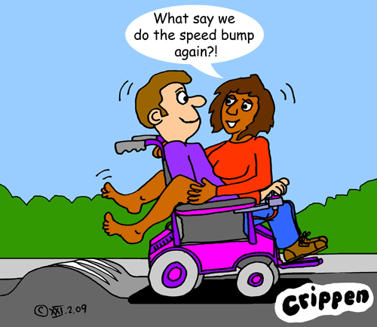
“We use the wheelchair as a toy,
not an obstacle.”

Slide 42
Resources
https://msktc.org/tbi/factsheets/sexuality-after-traumatic-brain-injury
https://www.biausa.org/wp-content/uploads/Sexual-Functioning-and-Satisfaction-after-Traumatic-Brain-Injury-.pdf
http://www.sexualityanddisability.org/
https://www.drmitchelltepper.com/sex_and_paralysis_video_series
https://assets2.hrc.org/files/assets/resources/Trans_Safer_Sex_Guide_FINAL.pdf
https://www.aasect.org/
Notes:
And I added the Trans safer sex guide to add this piece in, as maybe your rehab patients also identify as trans, and as the authors of the guide say “When it comes to sex, there’s a serious lack of resources available to trans people that talk about our bodies and our needs in a relatable and respectful way.” It’s a great guide for anyone, trans or not, so this can give you exposure to safe sex practices in general, with more inclusive language and frameworks.

Slide 43
Questions and Discussion

Slide 44
Thank you! To contact me: wright6@uw.edu

