Slide 1



TBI and PTSD:
How Do Comorbid Conditions Impact
Assessment and Treatment?
TBI-BH ECHO
Traumatic Brain Injury – Behavioral Health ECHO
UW Medicine | Psychiatry and Behavioral Sciences
Jay M. Uomoto, PhD
University of Washington School of Medicine
Department of Psychiatry and Behavioral Sciences
jayu2@uw.edu
7 February 2025

Slide 2
Speaker disclosures
Jay Uomoto PhD has no conflicts of interest to disclose
The following series planners have no conflicts of interest:
Jennifer Erickson DO
Jesse Fann MD
Cherry Junn MD
Chuck Bombardier PhD
Cara Towle MSN RN MA

Slide 3

Objectives
Participants will be able to describe common symptoms that overlap between TBI and PTSD
Participants will be able to describe key aspects of obtaining a TBI history and evaluating the severity of PTSD symptoms, noting challenges to each given symptom overlap
Participants will be able to implement treatment enhancements for PTSD in the context of different levels of TBI severity

Slide 4
Case Presentation*
42-year-old married woman, with 2 elementary school-aged children
Motor vehicle accident, the patient was the driver, who struck a telephone pole after skidding on black ice. No passengers in the car
Brief LOC, approximately 5 minutes. Confused, headache, nausea after impact
Able to call 911 for assistance; ambulance arrived to take to ER. The patient able to call her spouse to meet her at the ER
Taken to local ER. Glasgow Coma Scale = 13; CT Scan negative
Instructions. She was told to take Tylenol, rest for 48 hours, then resume normal activity
*Note: The details of this case are a composite of a few patients seen in different clinical settings.

Slide 5
How Frequently Does PTSD Occur After TBI?
Vasterling, J. J., Jacob, S. N., & Rasmusson, A (2018). Traumatic brain injury and posttraumatic stress disorder: Conceptual, diagnostic, and therapeutic considerations in the context of co-occurrence. Journal of Neuropsychiatry and Clinical Neurosciences, 30, 91-100.
Report on a study of N=1,084 patients presenting with physical injury to a civilian trauma center
Those diagnostic with mild TBI were twice as likely to have developed PTSD one year later
Medical records of ½ million US Air Force service members
Increased risk of PTSD after mild TBI a few months later
Failure to encode the trauma associated with the event of TBI
PTSD occurs more frequently with shorter period of posttraumatic amnesia and memory for the event
Military and combat-related TBI
Higher rates of PTSD after TBI versus civilian populations, though broader prevalence estimates occur in civilian sector studies

Slide 6
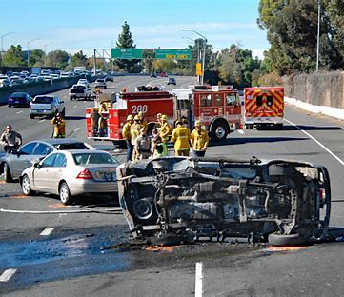
Trauma in the Context of Traumatic Brain Injury
Traumatic brain injury is an event
Consequences of TBI can persist, which can be experienced as trauma
Severity of TBI is a continuum though we diagnose categorically; severity of TBI often a consequence of the type, severity, and circumstances of the event
Need to consider TRAUMAtic in TBI when understanding the co-occurrence of TBI and PTSD
Emotional reactivity and psychological stress associated with the event of TBI:
  Motor vehicle accident (how it occurred; who was involved; injuries to those involved)
  Interpersonal violence and assaults

Slide 7
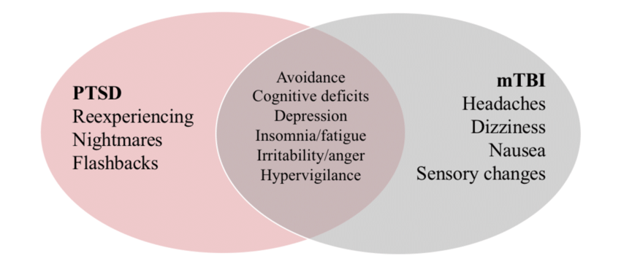
Overlap of Symptoms of PTSD and TBI
Source: Rusch, H. L. (2020). Links between stress, sleep, and inflammation: A translational perspective of resilience. PhD Thesis.
Notes:
Common overlapping symptoms:
Cognitive – attention difficulty, short-term memory,, impaired decision-making and reduced efficiency of information processing
Emotional – anxiety, depressed mood, irritability,
Behavioral – agitation, lethargy, withdrawal from social settings; more avoidance than re-experiencing symptoms of PTSD in those with TBI
Physical – fatigue, sleep disturbances

Slide 8

PTSD and TBI Co-Morbidity
Tanev, K. S., Pentel, K. Z., Kredlow, M. A. & Charney, M. E. (2014). PTSD and TBI co-morbidity: Scope, clinical presentation and treatment options. Brain Injury, 28, 261-270.
PTSD is strongly associated with suicidal ideation and attempts
More research needed on level of risk of suicide for those with co-occurring TBI and PTSD
PTSD associated with risk for developing chronic medical conditions: arthritis, back/neck pain, headaches, ulcers
Chronic pain is also a frequent problem after TBI, especially posttraumatic headaches
Neurocognitive impairments with co-occurring TBI and PTSD
Both conditions associated with neurocognitive dysfunction, objective measurement (neuropsychological evaluation) over self-reported cognitive impairment is recommended
Overlap of sleep disturbances, irritability, difficulty concentrating, slowed thinking, memory impairment; co-morbidities of depression, SUD, pain, and somatic disorders
Risk for misattribution of symptoms to one condition versus another

Slide 9
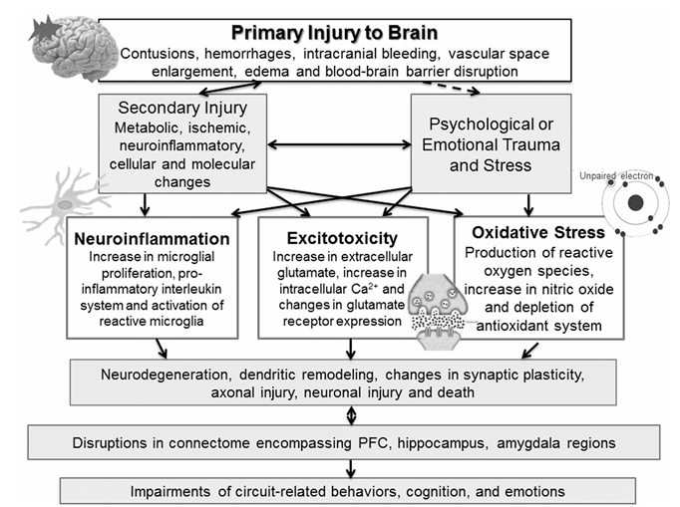
Pathophysiology PTSD and TBI
Kaplan, G., et al. (2018). Pathophysiological bases of comorbidity: Traumatic brain injury and post-traumatic stress disorder. Journal of Neurotrauma, 35, 210-225.
Notes:
FIG. 1. Pathophysiological mechanisms leading to the brain circuit disruption and symptomatology of comorbid traumatic brain injury (TBI) and post-traumatic stress disorder (PTSD). Physical trauma may produce psychological trauma (broken line) and results in primary and secondary brain injuries. Primary injuries include brain contusions, hemorrhages, and vascular damage. Secondary injuries follow primary brain injuries and represent metabolic, ischemic, cellular, and molecular events, and produce neuronal injury. Secondary injury from TBI and from psychological trauma produces at least three major neuropathologies: oxidative stress, neuroinflammation, and glutamatergic excitotoxicity. These neural changes from physical and psychological trauma result in neurodegeneration, synaptic plasticity, dendritic remodeling, and neuronal injury and cell death in the prefrontal cortex (PFC), hippocampal, amygdalar, and other circuits. These changes in neural pathways mediating executive function, attentional and cognitive control, fear responses, and behavioral inhibition produce resultant neural dysfunction and symptoms characteristic of comorbid TBI and PTSD

Slide 10
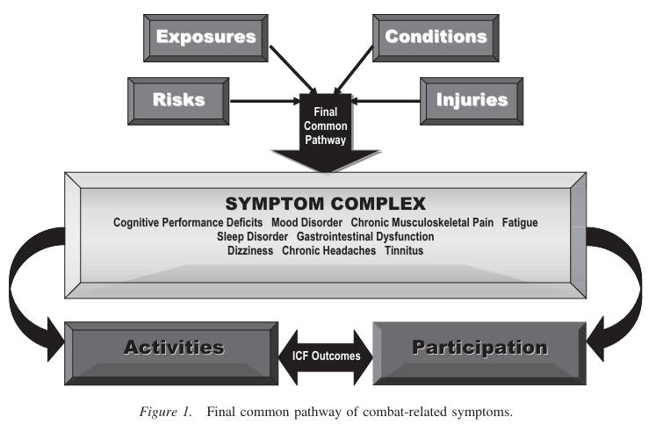
Co-Occurring PTSD and TBI: A Final Common Pathway
Uomoto, J. M. & Williams, R. M. (2009). Post-acute polytrauma rehabilitation and integrated care of returning veterans: Toward a holistic approach. Rehabilitation Psychology, 54, 259-269.

Slide 11
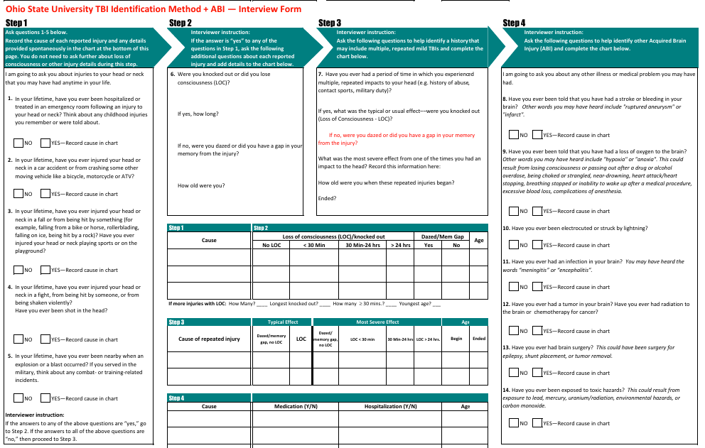
Diagnosing TBI: Ohio State University TBI Identification Method
Notes:
Obtaining LOC is difficult for the patient. They are not tracking how long they were out.
“What was the first thing you recall after the injury?” “What did you see when you awoke after the injury?”

Slide 12
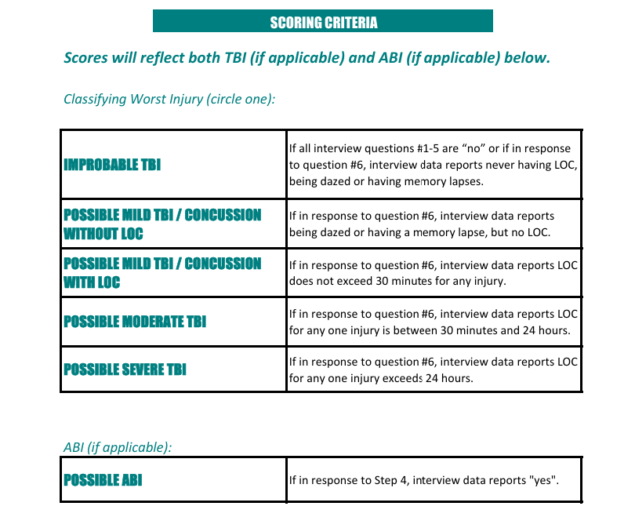
Diagnosing TBI: Ohio State University TBI Identification Method

Slide 13
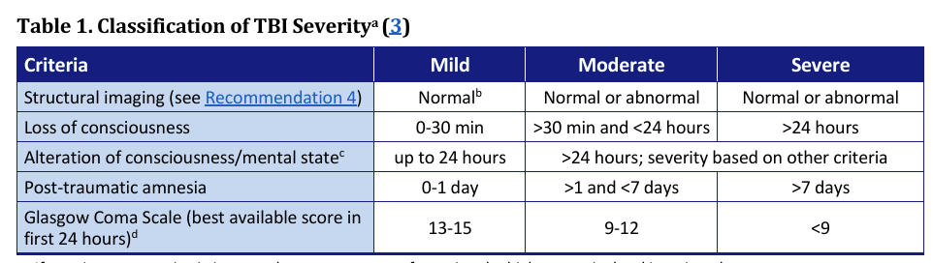
Classification of Traumatic Brain Injury Severity
Good Reference for Patients and Clinicians:
VA/DoD Clinical Practice Guideline for the Management and Rehabilitation of Post-Acute Mild Traumatic Brain Injury Version 3.0, June 2021
Good Reference for Patients and Clinicians:
CDC Traumatic Brain Injury and Concussion
Facts About TBI | Traumatic Brain Injury & Concussion | CDC
Notes:
Implications for assessment and treatment, with and without PTSD

Slide 14
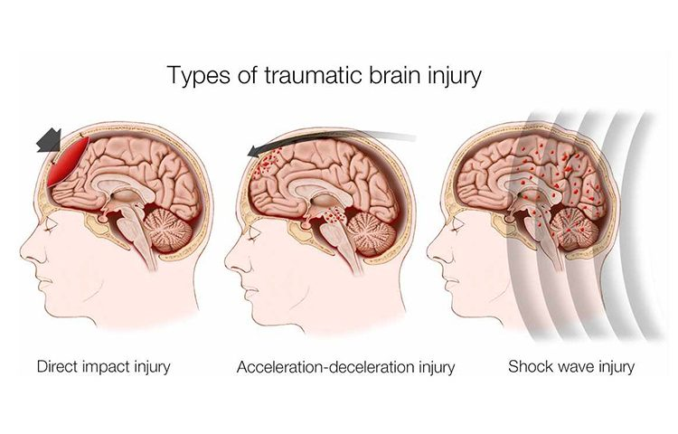
Classification of Traumatic Brain Injury Severity:
Some Considerations
Mechanism and circumstances of the injury
Retrospective reporting of injury details
Documentation is important to be accurate to what the patient states – civilian litigation considerations
Unless you are trained and have experience with formally diagnosing and treating those with TBI, recommend referral to a neurologist, physical medicine and rehabilitation physician, or neuropsychologist
Managing the consequences of TBI is typically an interdisciplinary endeavor
Notes:
Mechanism of injury – what trauma is associated with the mechanism; MVA as driver, passenger, as a pedestrian, hit by drunk driver, others injured in the accident.

Slide 15
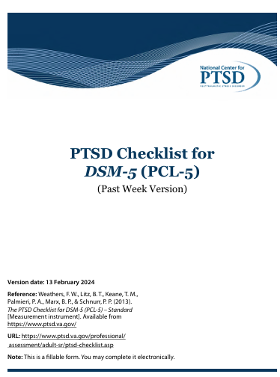
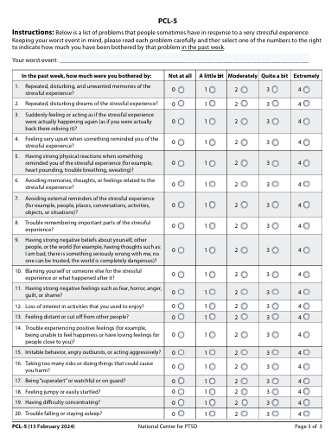
Evaluating PTSD Severity – PCL-5
Note: You may obtain copies of the PCL-5 with the various versions from the National Center for PTSD.

Slide 16
Evaluating PTSD Severity – PCL-5
20-items, 5-point Likert scale format, each items is scored from a 0 to 4
Assesses DSM-5 symptoms of PTSD
According to the National Center for PTSD, the PCL-5 is used for:
  Monitoring symptom change
  Screening individuals for PTSD
  Make a provisional PTSD diagnosis
  Gold standard is the Clinician-Administered PTSD Scale (CAPS-5)
Self-Report format. Past month and Past week versions
Notes:
Past month for a more aggregated assessment of PTSD symptom severity
Past week can be used for weekly monitoring of treatment progress

Slide 17
Evaluating PTSD Severity – PCL-5
PCL-5 Version with Criterion A
  Exposure to actual or threatened death, serious injury, or sexual violence in one or more of the following ways:
    Directly experiencing the traumatic event
    Witnessing the event(s) as they occurred to others
    Learning that a relative or close friend was exposed to a trauma

Slide 18
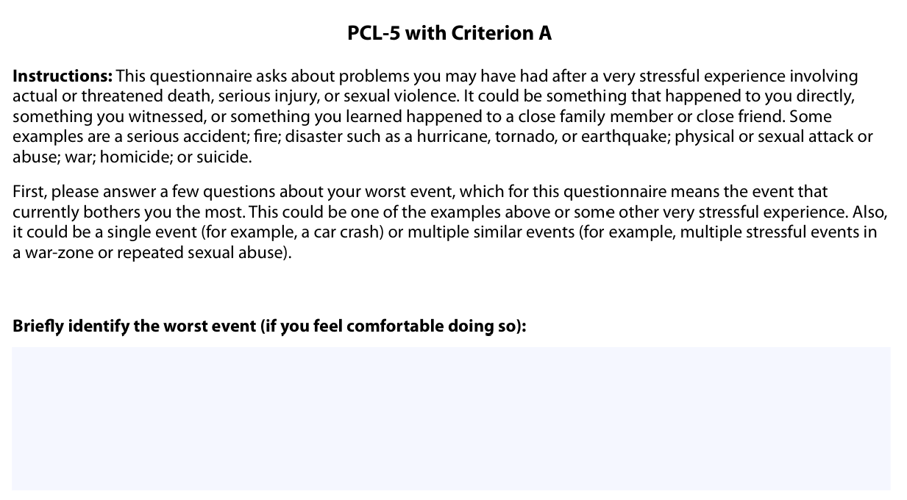
Evaluating PTSD Severity – PCL-5

Slide 19
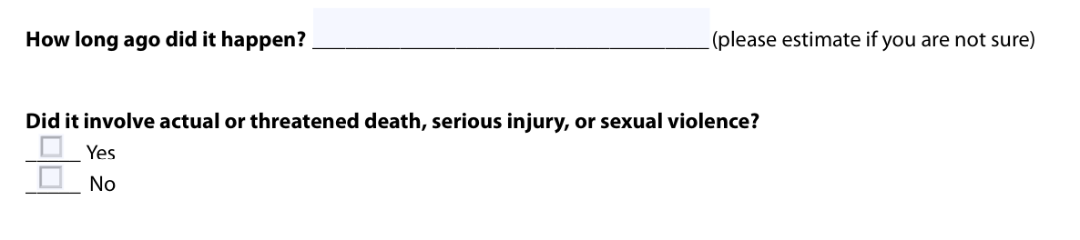
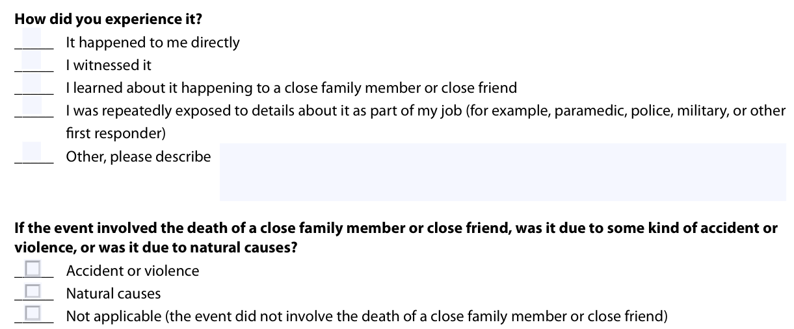
Evaluating PTSD Severity – PCL-5

Slide 20
Evaluating Change in PTSD Severity – PCL-5
5-10 score difference = reliable change
10-20 score difference = clinically significant change
Cutoff score of 33 is suggested = clinically significant symptoms
Scores of 31-33 have been suggested as indicative of probable PTSD
These scoring and interpretation guidelines were based on the PCL for DSM-IV; new score interpretations are forthcoming but likely to be similar

Slide 21
Evaluating Scores in Self-Report Measures

Slide 22
Notes:
Self-report bias
Questionnaire fatigue
“Cry for help” profiles

Slide 23
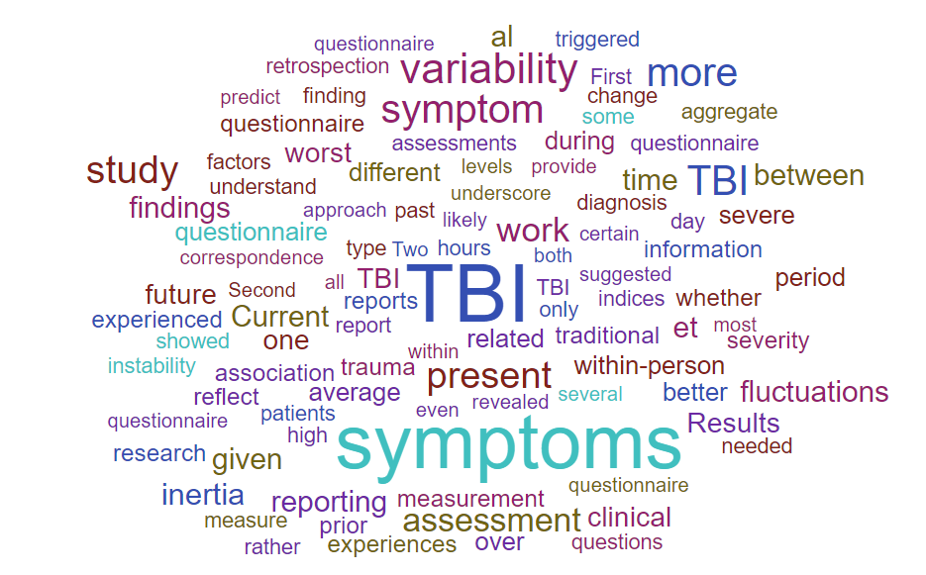

Limitations of Self-Report Measurement
Retrospective Bias
Reactivity Bias
Questionnaire Fatigue
Non-Credible Performance
Notes:
Acquiescence response set and social desirability
Extreme response set

Slide 26
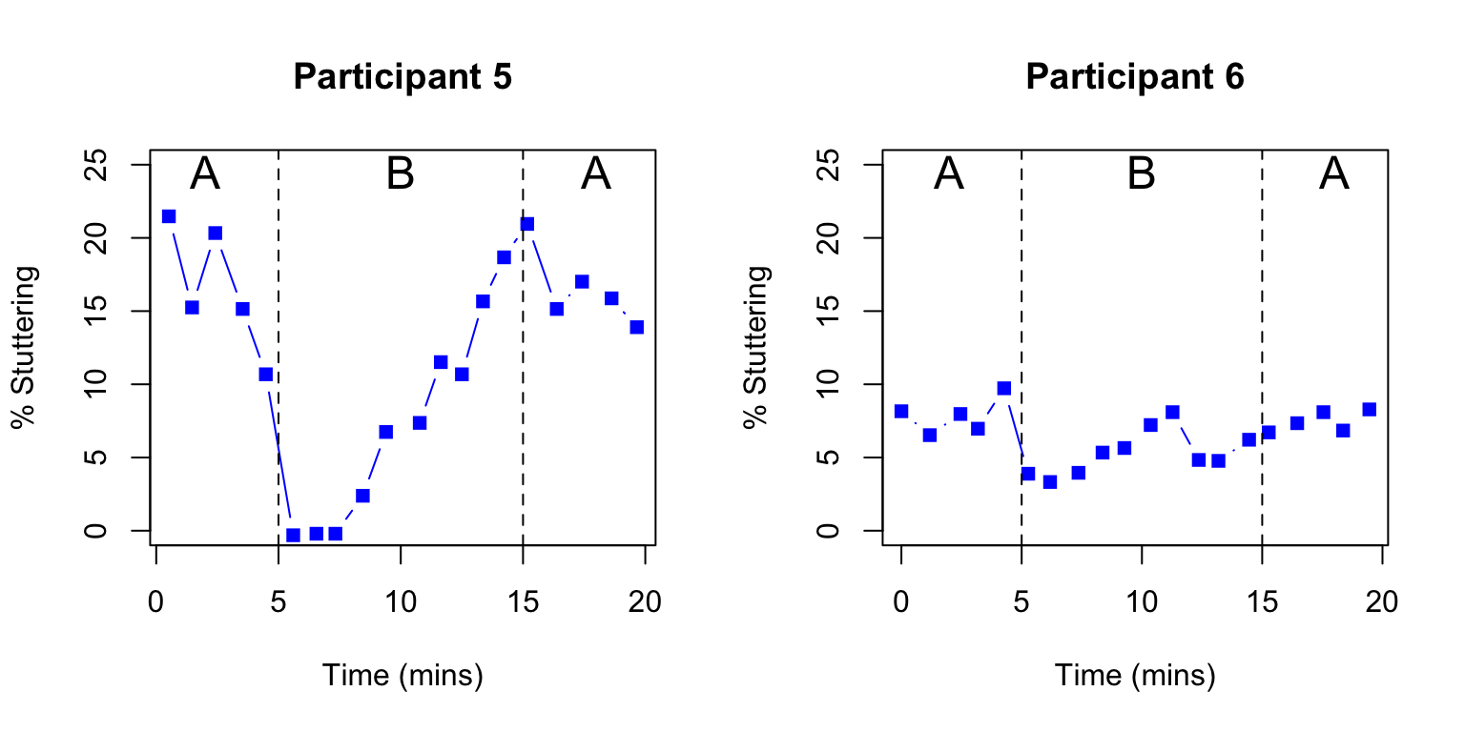
Limitations of Self-Report Measurement
Serial dependency effect
Notes:
People may tend not to deviate too far from a previous item response.

Slide 27

Some Assessment Recommendations

Slide 28
Some Assessment Recommendations
Review item responses carefully
Verify key item responses through clinical interview
Combine self-report measures with structured interview measures
Obtain collateral interviews with family, co-workers, and others if feasible and upon patient informed consent (explaining details of questions to be asked and limits of information you convey to others)
Self-report measures – clarify if responses reflect an aggregate of the “past two weeks” (or whatever the metric of the measure is), or reflective of a particularly emotionally eventful day(s).

Slide 29

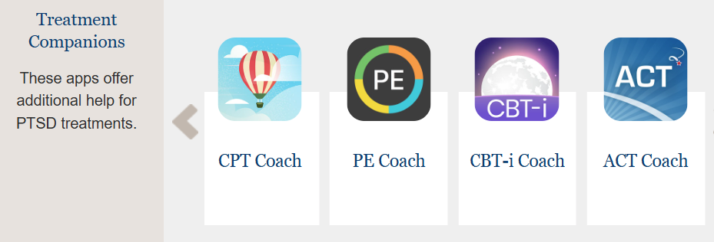
Treatment Enhancements for PTSD Interventions in the Context of TBI
Severity of TBI and type/severity of cognitive impairments may determine what enhancements/supports may be needed
  Attention problems may require further repetition of therapy content
  Cognitive scaffolding may be needed to carry out homework assignments – collateral assistance; electronic reminders; mobile apps may support
Mobile Apps for PTSD: See: Mobile Apps - PTSD: National Center for PTSD

Slide 30
Treatment Enhancements for PTSD Interventions in the Context of TBI
Consider the sequencing of PTSD treatment and interventions for the consequences of TBI
For mild TBI, EBTs can be delivered per protocol with success*
Sometimes rehabilitation therapies can enhance and support EBTs for PTSD
  Speech pathologist and/or OT can assist with memory capture systems and cognitive-compensatory strategies for homework/keeping symptom and thought diaries, etc.
*See Mikolić, A., Polinder, S., Helmrich, I. R. R., Haagsma, J. A., & Cnossen, M. C. (2019). Treatment for posttraumatic stress disorder in patients with a history of traumatic brain injury: a systematic review. Clinical psychology review, 73, 101776.

Slide 31
Treatment Enhancements for PTSD Interventions in the Context of TBI
Consider treatments that may provide an avenue to perceived “more difficult” evidence-based treatment (e.g., Prolonged exposure; cognitive processing therapy)
  Cognitive processing therapy-cognitive therapy only (CPT-C)¹
  Behavioral activation for PTSD²
1 – Walter, K. H., Dickstein, B. D., Barnes, S. M. & Chard, K. M. (2014). Comparing effectiveness of CPT to CPT-C among U.S. veterans in an interdisciplinary residential PTSD/TBI treatment program. Journal of Traumatic Stress, 27, 438-435.
2 – Etherton, J. L. & Farley, R. (2022). Behavioral activation for PTSD: A meta-analysis. Psychological Trauma: Theory, Research, Practice, and Policy, 14, 894-901.

